Slide 1
University of Southampton

Slide 2
Better content, made easy!
Using the office accessibility inspector
1 September 2022
Notes:
Did you share with sound turned on?
Hi everyone! Welcome to “Better content, made easy!” where we will introduce you to the accessibility inspector in Office. We’ll take breaks for questions throughout this session so put any questions you have in the chat or wait for the question break and raise your hand and we’ll try to answer any questions throughout the session. You can also find the slides for today’s session in the chat.

Slide 3




What if there was a way to
make your documents, presentations, and spreadsheets more professional,
improve your efficiency in Blackboard,
make the world a better place for all,
…and is easy to do!
Notes:
What if I told you there was a way to make your documents, presentations, and spreadsheets more professional,
[progress]
improve your efficiency in Blackboard,
[progress]
make the world a better place for all,
[progress]
…and that was easy?
Sounds pretty amazing, right?

Slide 4






Hello, accessibility inspector!
Identifies possible accessibility improvements.
Runs whilst you work.
Helps you to make your content more accessible.
Notes:
Today we introduce you to the accessibility inspector in Word, PowerPoint, and Excel..
[progress]
The accessibility inspector identifies possible improvements you can make to the accessibility of your document.
[progress]
It runs whilst you’re working
[progress]
And it will show you how to make your document more accessible.

Slide 5

Why use the accessibility inspector?
Helps make your content more accessible.
Increases your efficiency in Blackboard.
Enhances your professional credibility.
Notes:
Accessibility is about removing barriers that might prevent colleagues, students, or the general public from getting the most out of our resources, particularly if they have an impairment or disability. Accessible content is just better content.
If you use Blackboard, you’re probably used to seeing the accessibility indicators.
[progress]
These give you instant feedback on the accessibility of the content you upload for your students.
The accessibility inspector in office takes you further. It points out issues whilst you create content. It’s more efficient to resolve issues before you upload content to Blackboard.
As a professional, you want your audience to focus on your content. When content shows poor accessibility practice it can be frustrating. For example when text has too little contrast you might be distracted trying to make out what is on screen and lose focus. Or if you open up a large document and find you cannot navigate through it using headings and you’re in a rush, it’s likely that you will be distracted by the problems the content is causing you, not the solutions you were expecting to find in the content.
Even if your audience does not know about accessibility, if you follow good accessibility practice it’s more likely that you will get the results you want. While usually we don’t notice when something is good, we often notice when something is bad.

Slide 6

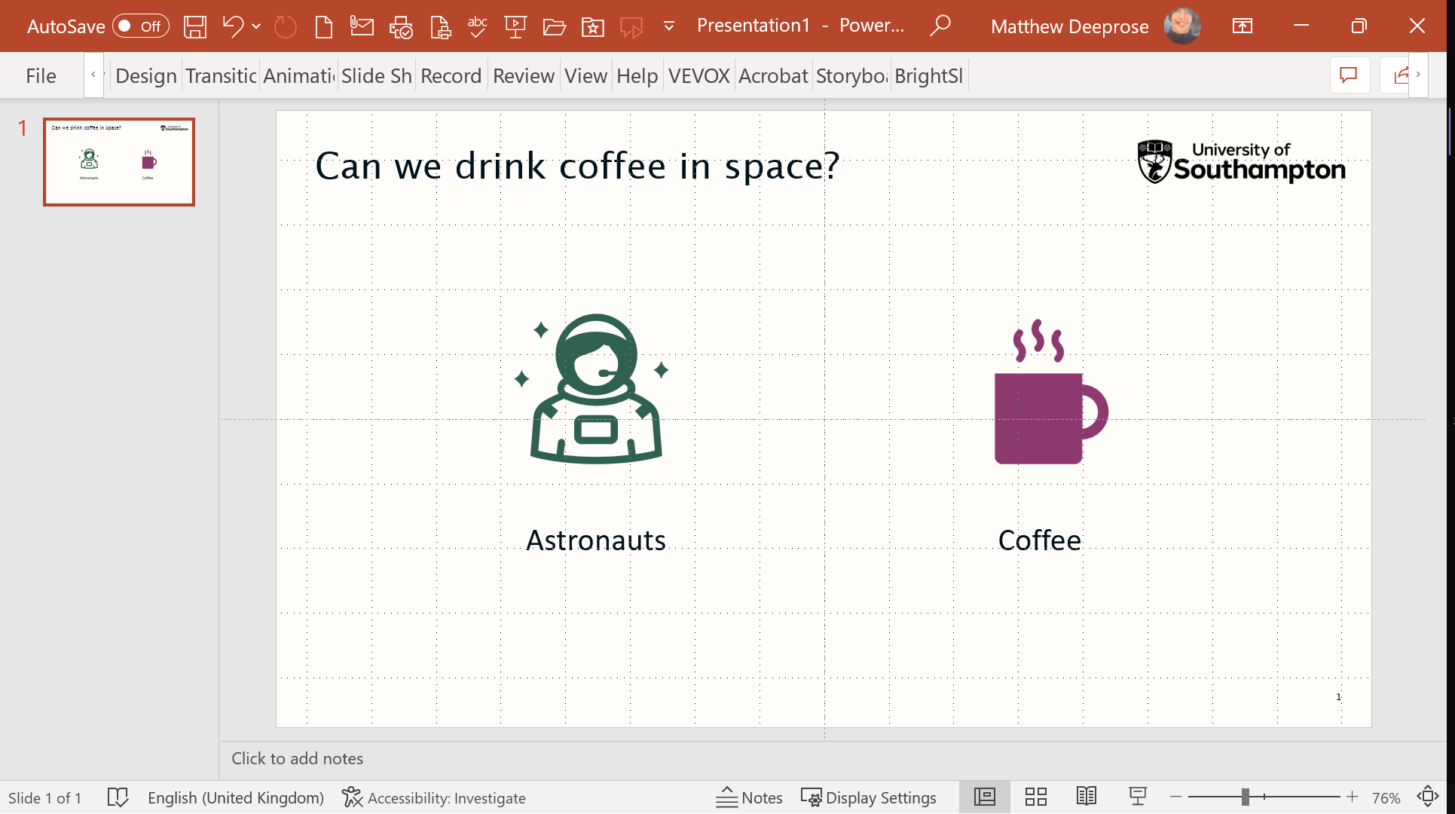

Where is it?
Notes:
So where is the accessibility inspector and how does it work?
[progress]
It appears as a button in Word, PowerPoint and Excel at the bottom left centre of the screen. This is the Office programs, we’ll talk about what happens if you use Office in a web browser in a moment. It will either say “Accessibility: investigate”, or “Accessibility: Good to go”. Select the button to open it.

Slide 7
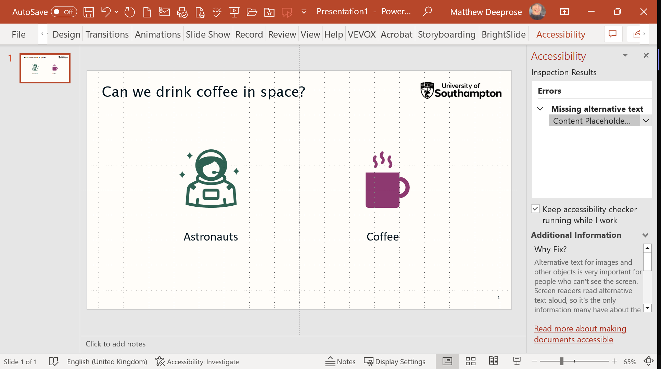
Demonstration 1
Notes:
Having selected the button, a panel appears on the right of the screen that lists any accessibility issues the inspector has found.

Slide 8
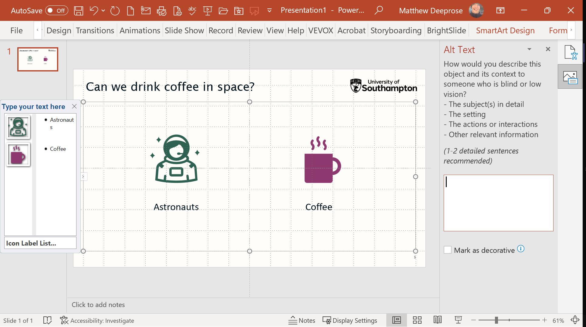
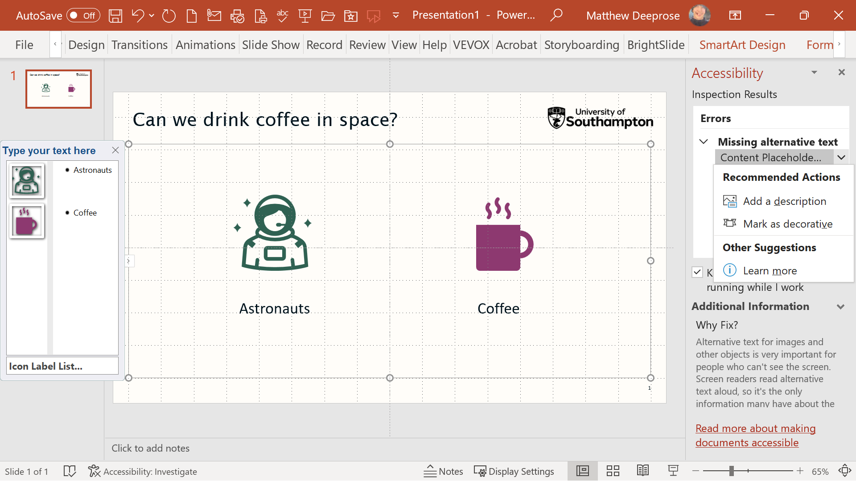
Demonstration 2
Notes:
In this case it’s some missing alternative text. We covered writing alternative text in a session back in May.
So in the screenshot now we have selected the error. The inspector gives us some choices and links to learn more.
[progress]
In this example I’ve selected “add a description”, and now I can enter my alternative text.
By alerting us to issues whilst we create a document, it makes it easy for us to resolve accessibility issues right here and now.

Slide 9
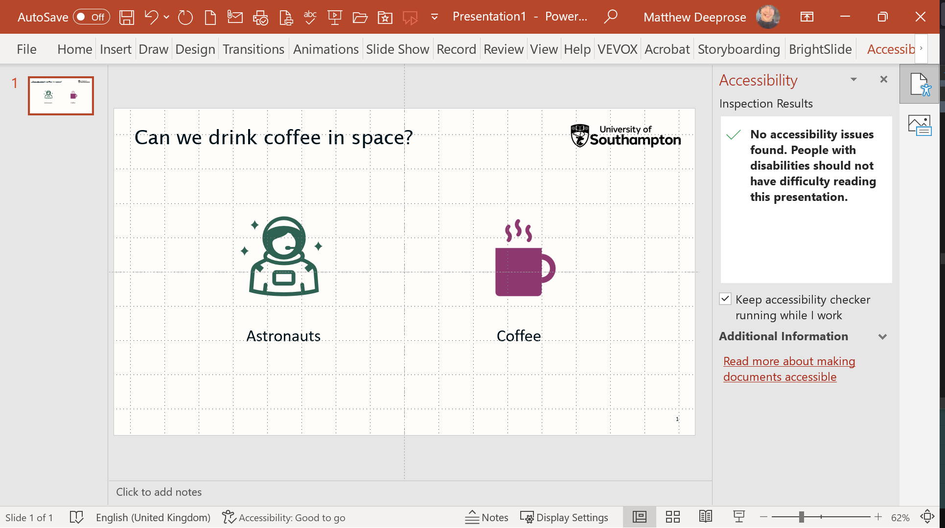
Demonstration 3
Notes:
Once we have resolved all the issues that the inspector has identified
[progress]
, the button changes to “Accessibility: good to go”.
This means we have resolved all the issues that the inspector has identified. It doesn’t mean our document is perfect, it just means we’ve resolved the issues that the computer was able to detect automatically. We’ll be covering issues that the inspector can’t find in future sessions.

Slide 10
If you don’t see the inspector
Notes:
If you are using a PC that is managed by the University, the accessibility inspector should appear while you work, but it’s possible that this isn’t the case, or you might be using a personal or other non-University PC.

Slide 11
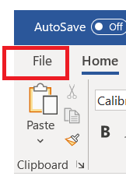
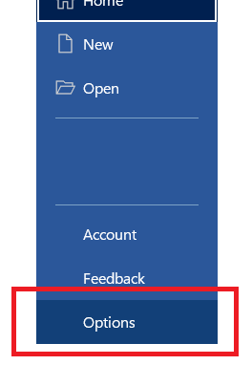
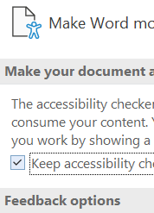
Turning on the accessibility inspector
Notes:
To turn the inspector on in Windows, go to the file menu
[progress]
Select options
[progress]
And from the ease of access section, select “Keep accessibility checker running while I work”
You need to do this in each of Word, PowerPoint and Excel.

Slide 12
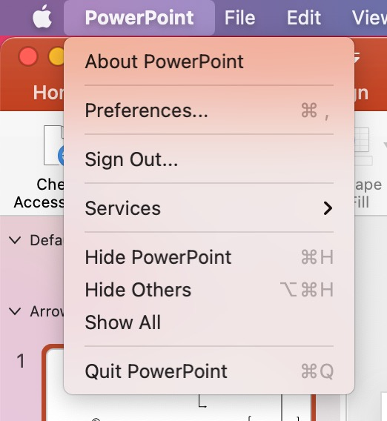
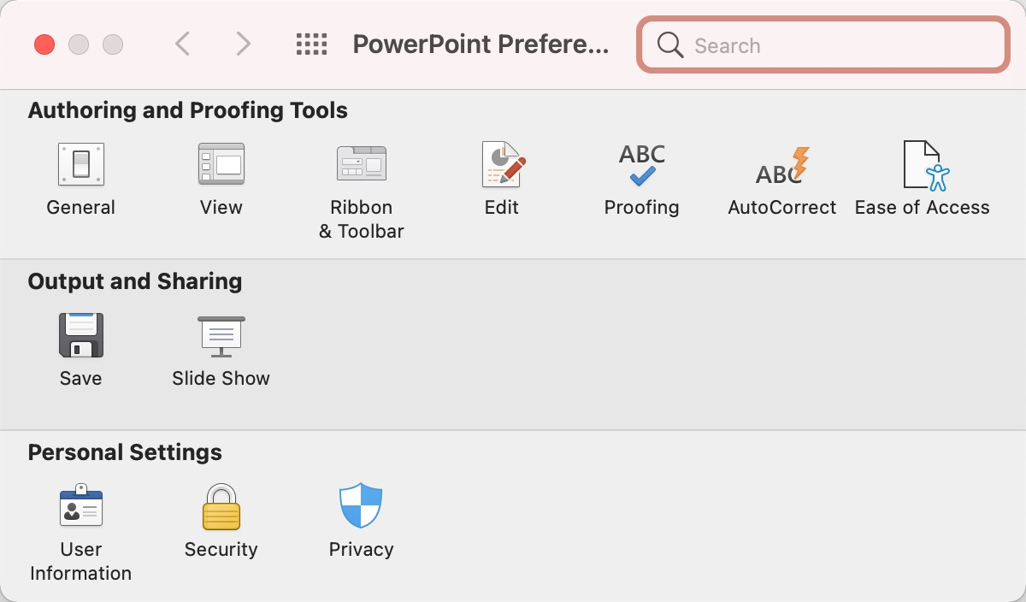
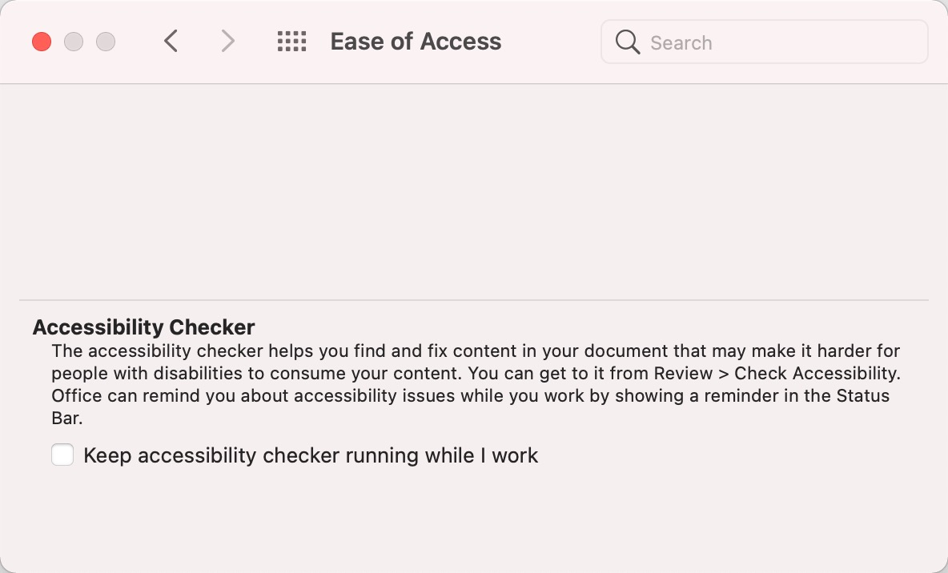
On a Mac?
Notes:
If you are using a Mac, Open one of PowerPoint, Excel or Word and open preferences.
[progress]
Choose Ease of Access
[progress]
And under Accessibility checker, select “keep accessibility checker running while I work”

Slide 13
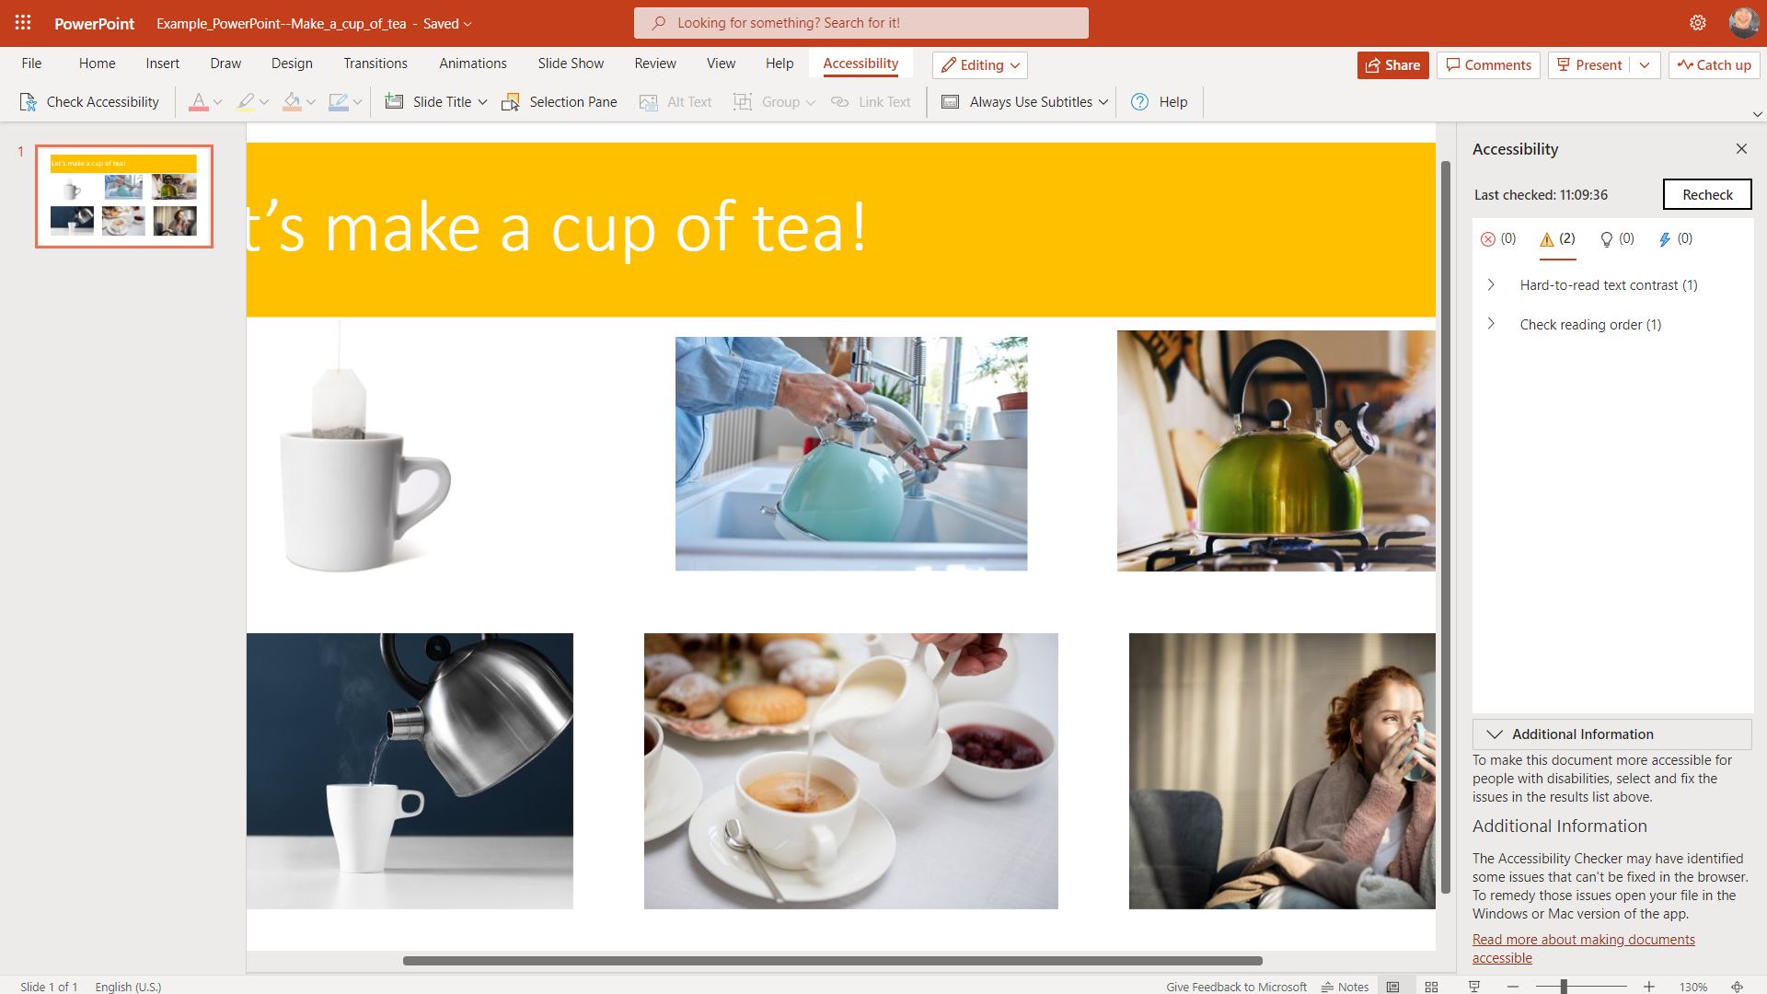
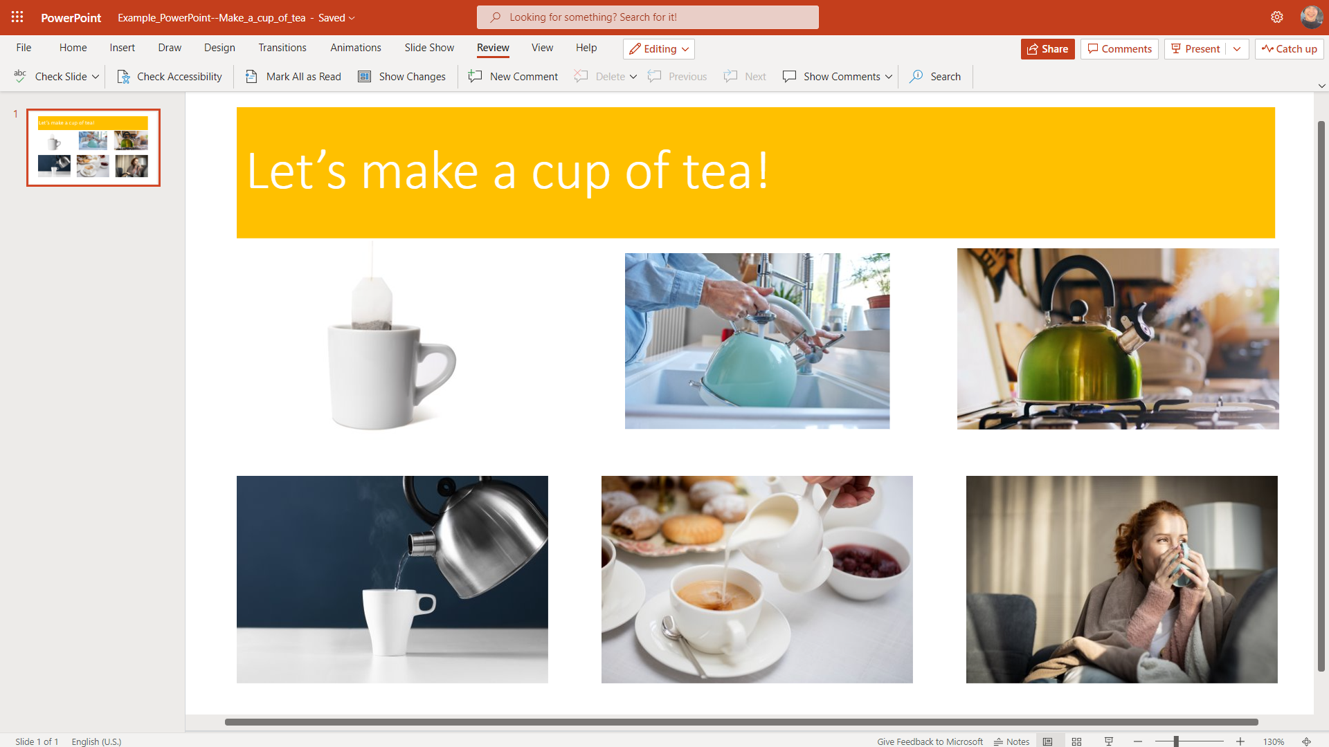
Using browser-based Office?
Notes:
So far we’ve talked about using office programs on your computer. You can also use Office within your web browser. There isn’t an accessibility inspector in browser-based office. You can check for accessibility issues though.
[progress]
Open the review tab
[progress]
And select check accessibility
[progress]
Any accessibility issues it can detect will be shown on the right
[progress]
The view if filtered by issue priority, use the buttons to change the filters and view all the identified issues in the document. Select an issue to find out how to resolve it.

Slide 14

Today’s session
Word
PowerPoint
Excel
Conclusion
Headings
Tables
Reading Order
Contrast
Red-only formatting
Alternative text
Notes:
In today’s session we’re going to look at using the accessibility inspector in Word, PowerPoint, and Excel. The accessibility inspector can spot 16 different issues. We’re going to look at six issues today.
16 checks in total https://support.microsoft.com/en-us/office/rules-for-the-accessibility-checker-651e08f2-0fc3-4e10-aaca-74b4a67101c1

Slide 15

Accessibility inspector and Word
Notes:
So lets start by diving into Word.

Slide 16
Demonstration (Word)

Slide 17
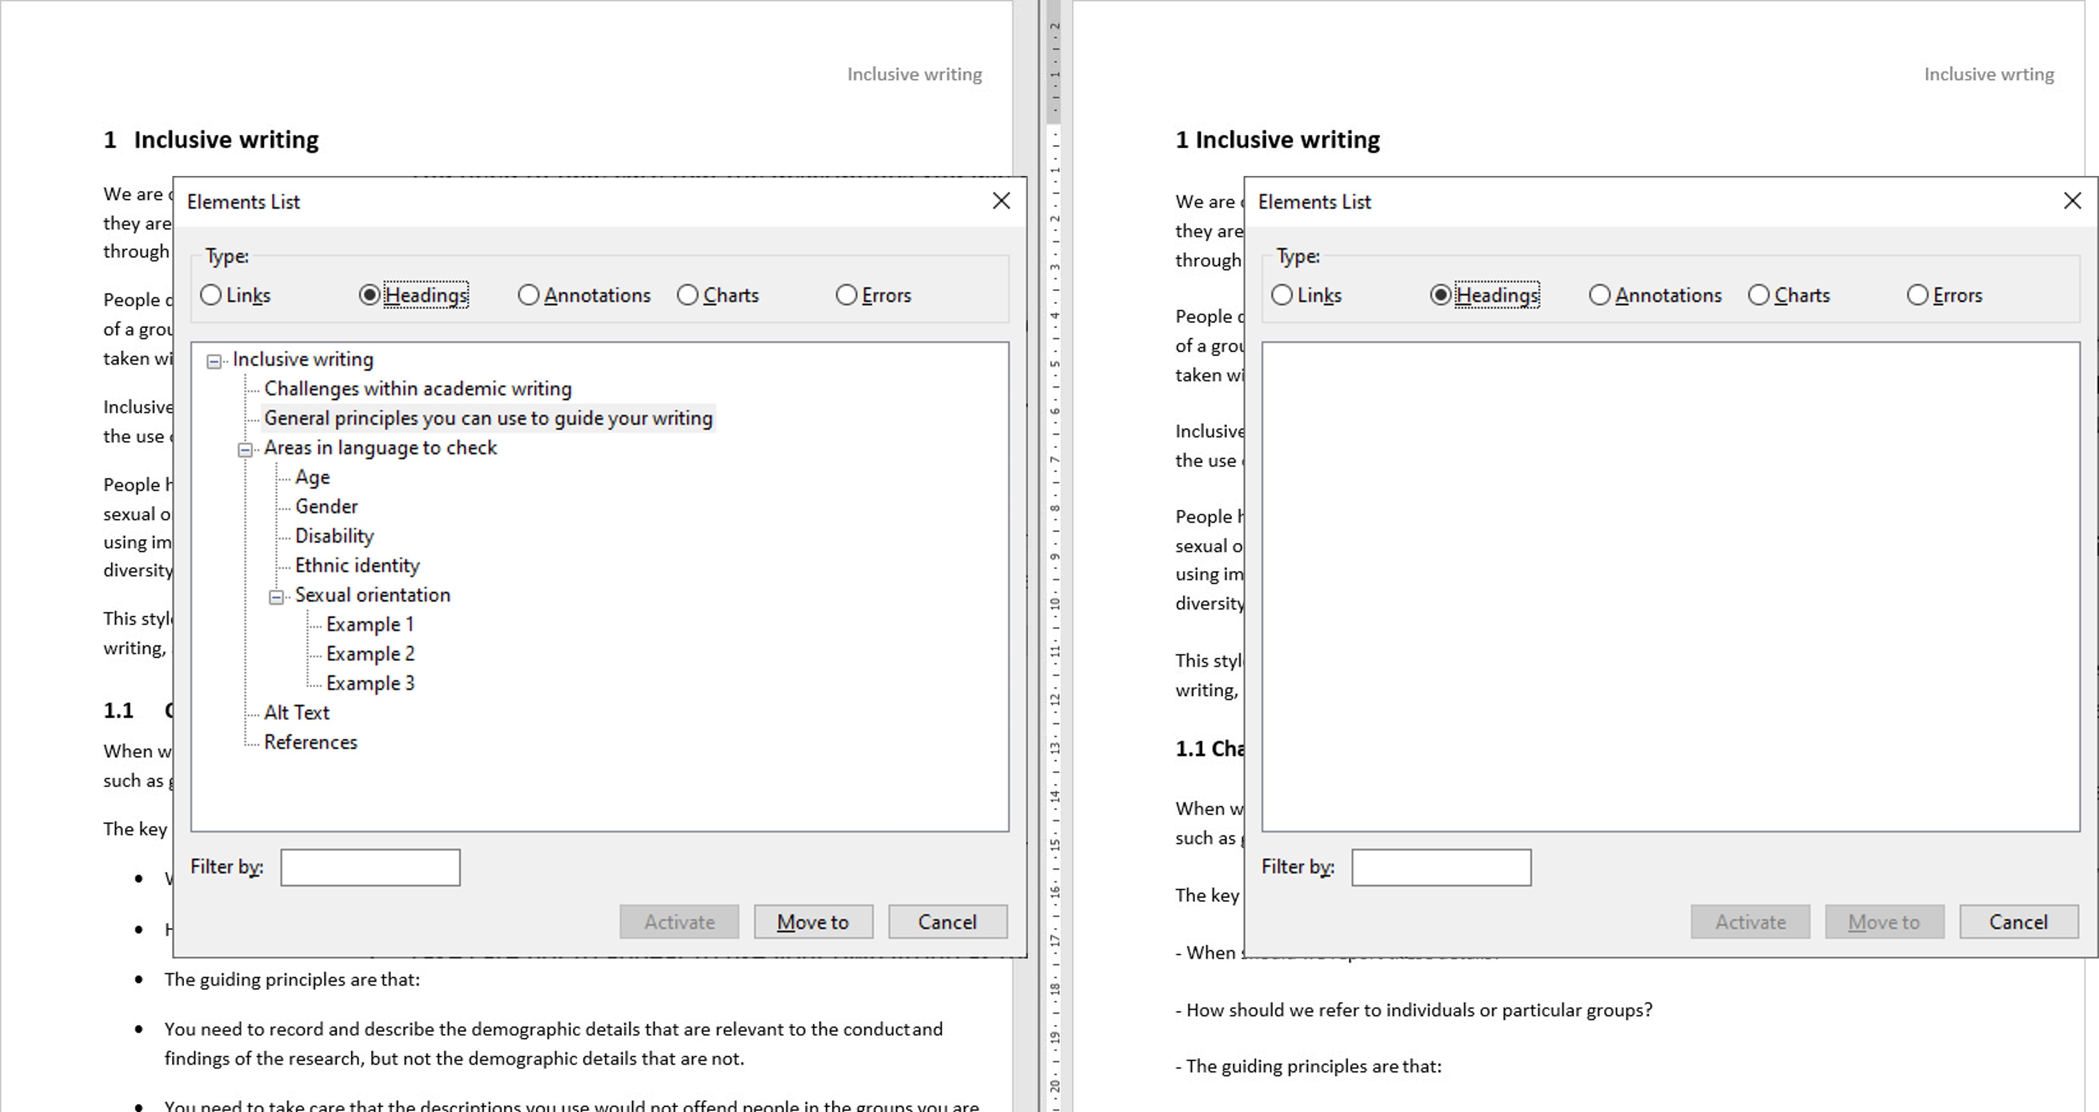
NVDA Headings view
Notes:
A screen reader is a piece of assistive technology that reads out what is on screen. Many of those who use screen readers will navigate a page in a different way than you might be used to. One such method is to navigate through the headings of a document or page. On screen are two documents. The NVDA screen reader has been set up to show the headings in the document. While the documents look the same, only one shows headings to navigate. This is because only one document has had headings set up using heading styles. The other simply uses bold text and an enlarged font to visually show headings.
A screen reader user can navigate quickly through the document with headings to find the content they want. They will have to listen through the whole document to find what they are interested in within the document without headings.

Slide 18
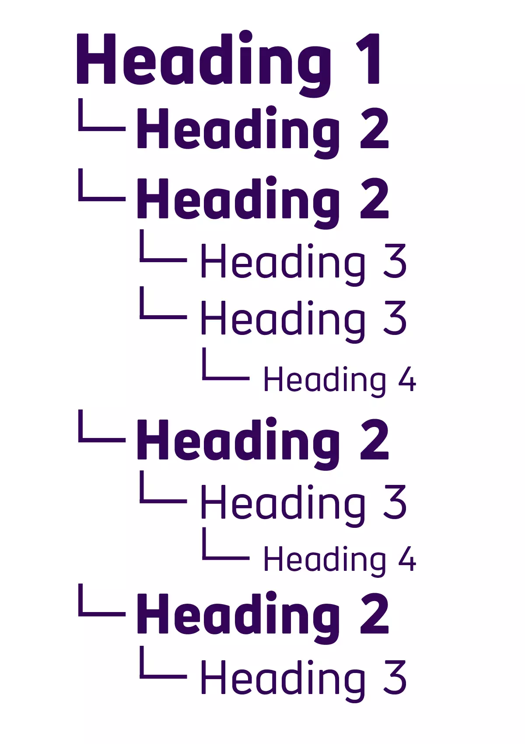
Heading structure
Image source: The Big Hack
Notes:
Keep headings in sequence. Don’t skip for example from heading 3 to heading 5.

Slide 19
Explaining table headings 1

Slide 20
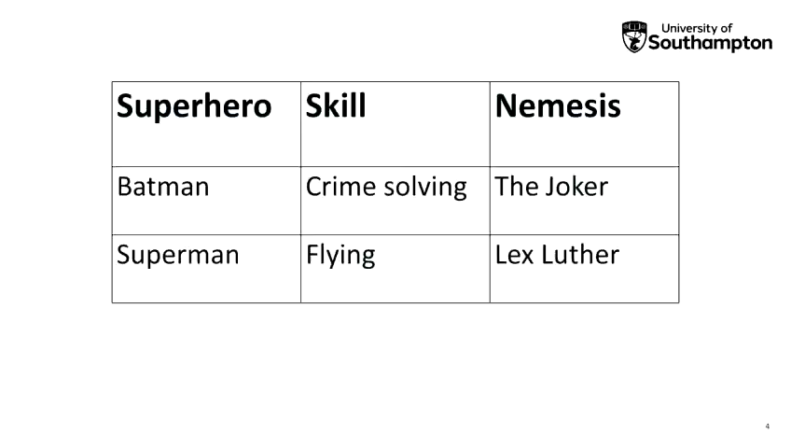
Explaining table headings 2

Slide 21

Explaining table headings 3

Slide 22
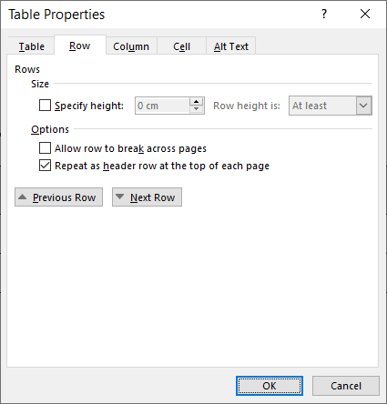
Making a table header accessible in Word
Select the header row.
Right click within the header row you have selected and choose Table properties, and then select the Row tab.
Tick “Repeat as header row at the top of each page”
Untick “Allow row to break across pages”

Slide 23
Word accessibility, helpful links
Improve accessibility with heading styles (Microsoft)
Create accessible tables in Word (Microsoft)
Styles and outline levels [in Word] (LinkedIn Learning)
Tagging tables [in Word] (LinkedIn Learning)

Slide 24
Questions? (Word)
Notes:
Let’s take a break and run through any questions from the chat, and if you have a question you would like to discuss please raise your hand.

Slide 25
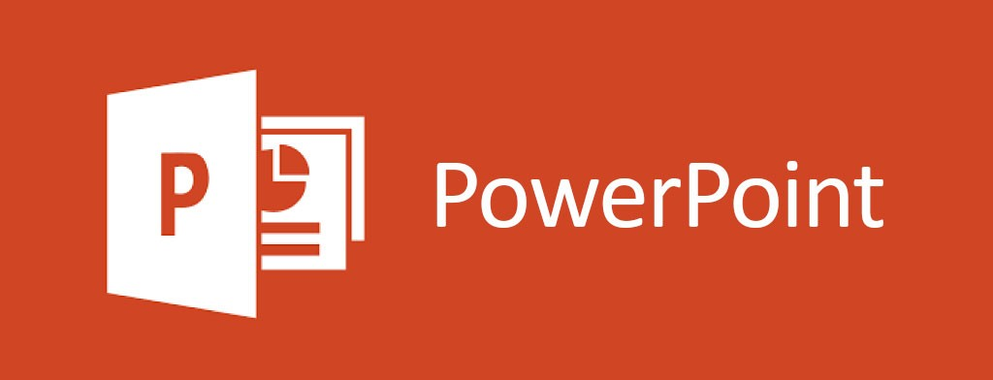
Accessibility inspector and PowerPoint
Notes:
We’re now going to look at PowerPoint.

Slide 26
Demonstration ((PowerPoint))

Slide 27

Contrast?
Notes:
Let’s take a moment to consider colour contrast. We’ll run a dedicated session on this topic in a few months, but we’ll give you a quick overview for now.

Slide 28


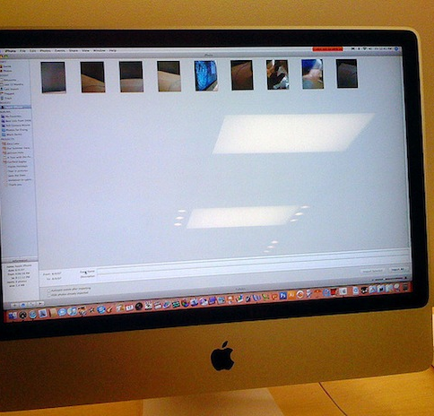
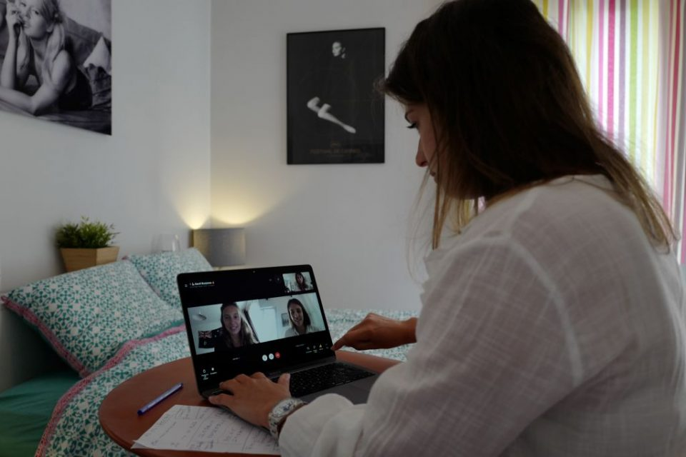
Why is good contrast important?
Using a mobile in outdoors
Steve Mason/Photodisc/Getty Images
A projector screen in a well-lit room
pxfuel.com - Creative Commons Zero - CC0
Screen glare
Luke Domy / CC BY-NC-ND 2.0
Working in a poorly lit room.
Getty Images
Notes:
Using sufficient contrast is important for many reasons. You’re likely to have encountered situational impairments like trying to use a screen in a bright light, or a projector screen in a poorly lit room, you’ve probably encountered screen glare that can make it hard to read what’s on screen, or just working in a room with poor lighting.
Our ability to distinguish contrast also reduces as we age. Good contrast can also help those who are colour blind, have low vision, or other visual impairments.

Slide 29
Explaining Colour Contrast
Hard to read
Hard to read
Hard to read
1.19:1
1.64:1
1.84:1
Hard to read?
Hard to read?
Hard to read?
2.71:1
2.96:1
4:1
Easy to read
Easy to read
Easy to read
7.58:1
15.27:1
21:1
Notes:
We’re going to cover this in more detail in a future session, but if there’s time we can explain a bit more about colour contrast right now.
Here I’m sharing nine boxes in rows of three. Each box has a different coloured background and white or black text.
[progress]
The top row is harder to read because the colour of the text has LOW contrast to the background colour.
[progress]
The bottom row is easier to read. The text colour has higher contrast with the background colour.
[progress]
What about this middle row? Some might find it easy to read, some may disagree? How do we know how much contrast is sufficient?
The web content accessibility guidelines, which I’ll shorten to WCAG, provide a calculation for assessing colour contrast. The result is a ratio, the higher the number the better.
[progress]
I’ve revealed the contrast ratios for these boxes. The top row are all low numbers below 2:1 those would all fail. The bottom row are all high numbers, all are over 7:1 and would pass because they go beyond the minimum level of contrast.
The middle row are all 4 to one or lower. Those would all FAIL the minimum contrast ratio for the presentation of text.

Slide 30
Contrast
3:1
7:1
(not to scale)
Minimum for Text
AA
AAA
Minimum for Graphical Objects / UI
4.5:1
Enhanced level for Text
1.4.11 Non-text Contrast (Level AA)
1.4.3 Contrast (Minimum) (Level AA)
1.4.6 Contrast (Enhanced) (Level AAA):
Notes:
The web content accessibility guidelines state that a contrast ratio of 3:1 is the minimum level of contrast for graphical objects like icons. This is not enough contrast for the presentation for text.
[progress]
A contrast level of 4.5:1 is the minimum for text
[progress]
7:1 and higher is the minimum for text when we want to reach the AAA level of accessibility.
The accessibility inspector in Office keeps it simple, it checks that text meets the minimum requirement for contrast with the background.

Slide 31
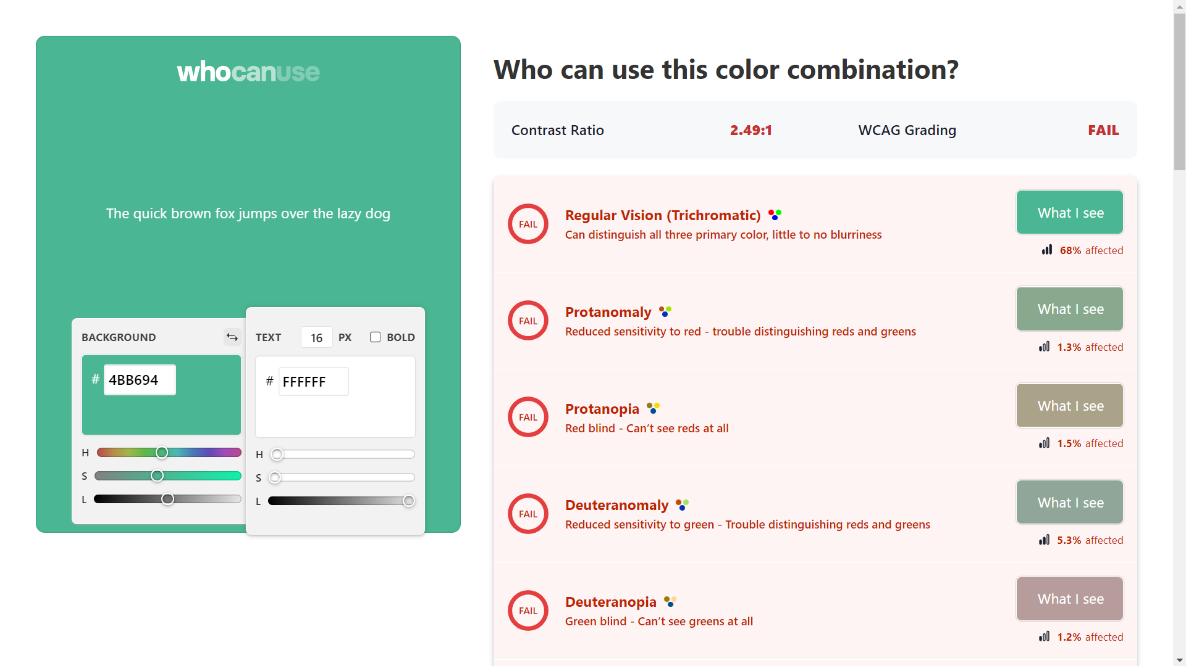
Checking colour contrast
https://whocanuse.com
Notes:
We’ll talk much more about contrast in a future event. There are many ways to calculate contrast ratios, my favourite is the website who can use .com.
You can enter the codes for the two colours you wish to check and it will give you a contrast ratio and a grading. It will also show how the colour combination will perform for those with different types of visual impairment.

Slide 32

Be aware
Introduction
Actions from last meeting
AOB
Office will not alert you to contrast issues in:
Images
Shapes / graphics
Design Ideas
Notes:
The accessibility inspector won’t identify all contrast issues. It doesn’t work on images, like this flyer for a summer party which is a graphic of text does not have enough contrast (1.81:1)
Shapes and graphics you make won’t be checked for contrast. (1.41:1, 1.32:1, 1.41:1)
And if you use Design Ideas to make a slide look more engauging, PowerPoint may suggest colours that have insufficient contrast too, this is dependent particularly on how the template has been set up. (2.84:1, 2.61:1, 1.67:1).

Slide 33
Making it easy
Lighter text on a darker background is easy to read
Darker text on a lighter background is easy to read
Notes:
The main thing to remember is that lighter text on a darker background will be easier to read and give good contrast, likewise darker text on a lighter background is easier to read.

Slide 34

Explaining reading order

Slide 35

Explaining reading order 2

Slide 36
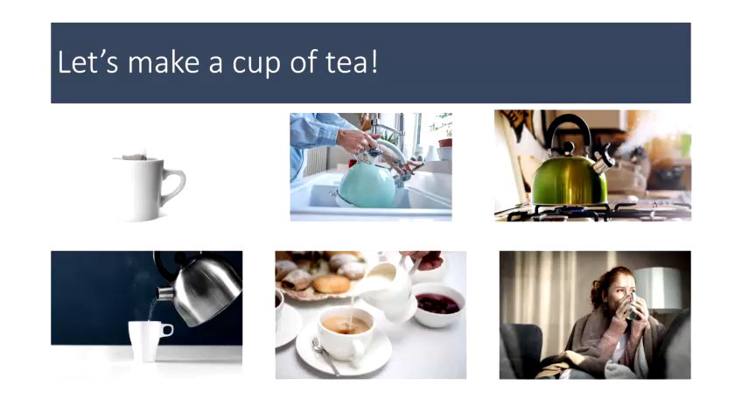
Explaining reading order 3

Slide 37
PowerPoint accessibility, helpful links
Contrast
Make your PowerPoint presentations accessible (Microsoft)
Use Colour Contrast in PowerPoint (Accessible by design)
Colour contrast in documents (University of Washington)
Reading Order
Make slides easier to read by using the Reading Order pane (Microsoft)
Set the Reading Order of a PowerPoint Slide (York University)
Create slides with an accessible reading order (Video by Microsoft)

Slide 38
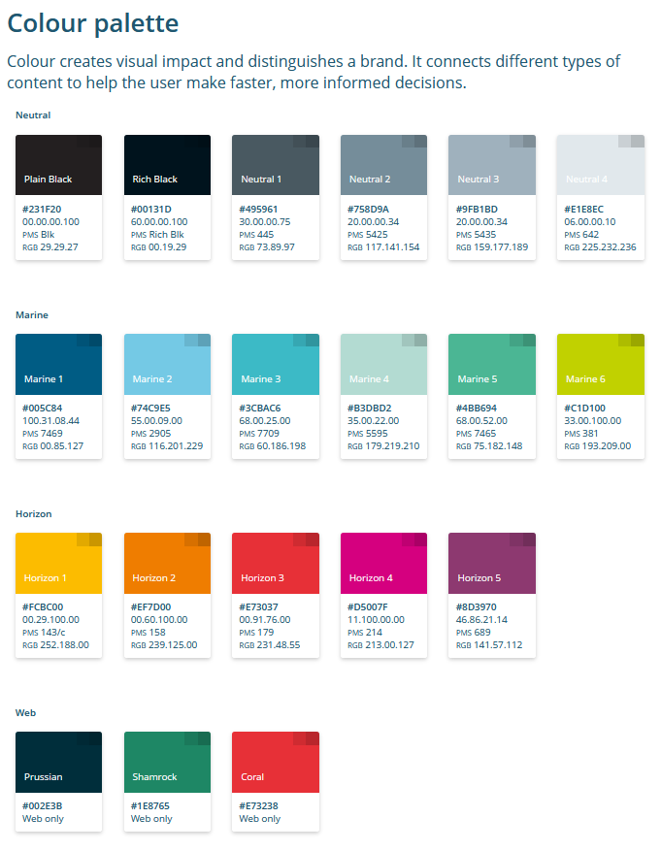
Using the UoS brand
Brand Accessibility Matrix
Brand Accessible Colour Suggester

Slide 39
Questions? (PowerPoint)
Notes:
Let’s take a break and run through any questions from the chat, and if you have a question you would like to discuss please raise your hand.

Slide 40

Accessibility inspector and Excel
Notes:
Now Luke is going to take us through using the accessibility inspector in Excel.

Slide 41
Demonstration (((excel)))
Notes:
Thank you, Matt.
Today I am going to show you how to remediate two issues that are common in Microsoft Excel.
These issues being cells that are set to Number format and use only the red color for negative numbers (e.g., show 1000 in red instead of -1000.) and all non-text content has alternative text.
Colour filter in Windows 10 settings will be beneficial to explain the point.

Slide 42
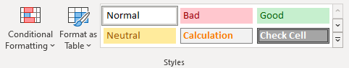
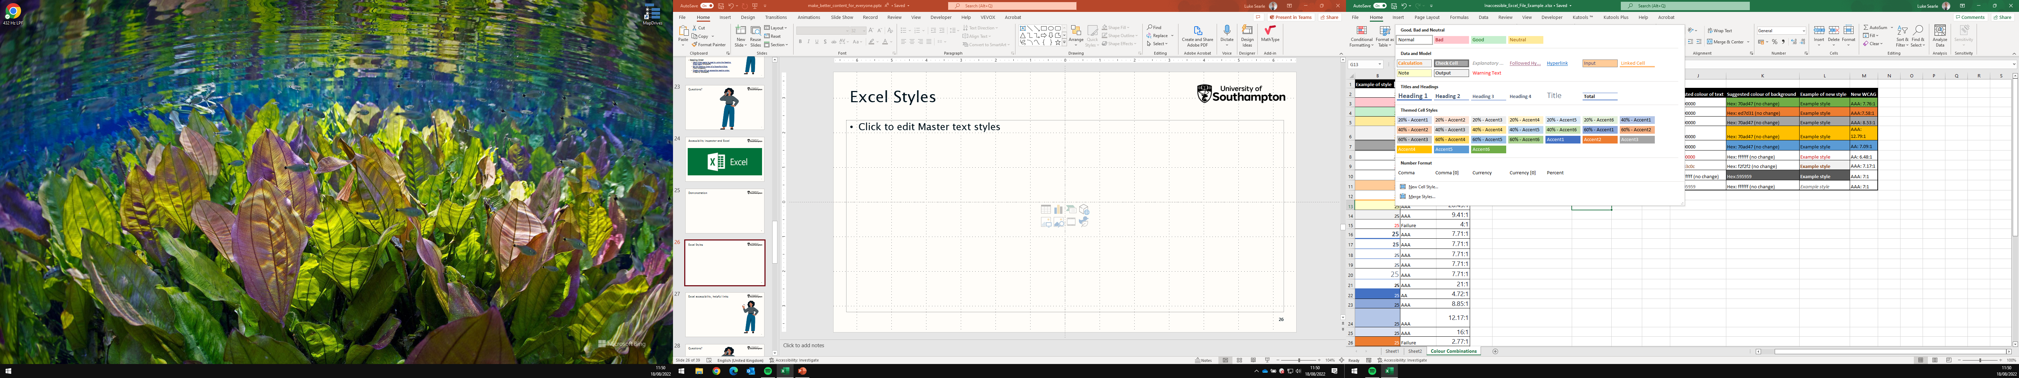
Styles Gallery in Excel
Notes:
Some of the default styles are not accessible.
The Calculation, Check cell Explanatory text, Linked cell and Warning text as well as Accent 2, 3, 4, 5 and 6 styles, all use colour combinations which could pose a barrier.

Slide 43

Conditional formatting in Excel
Name of conditional formatting style | Example of style | WCAG rating | WCAG ratio
Light red fill with dark red text | Example text | AA | 5.92:1
Yellow fill with dark yellow text | Example text | AA | 4.66:1
Green fill with dark green text | Example text | AA | 6.14:1
Light red fill | Example text | AAA | 14.31:1
Red Text | Example text | AAA | 8.69:1
Red border | Example text | N/A | N/A
Notes:
All of the default conditional formatting rules are accessible.
If you want to format your own conditional rules for better clarity you can with the “Custom format” option.
Be aware this is a use of colour only formatting, which can be problematic for other users.

Slide 44
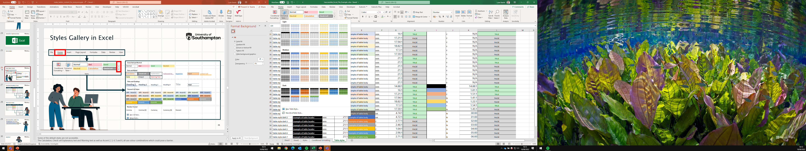

Table Styles in Excel
48% of the default table styles are accessible colour combinations.
Notes:
Table styles can greatly affect the clarity of data contained within the table.
Out of the 60 default styles available;
48% had either an AA or AAA rated colour combinations in both the header row and the table body.
32% had either an AA or AAA rated colour combination in both the header row and the table body and a greater contrast than the default cell outline for the table structure.
15% had either an AA or AAA rated colour combination in both the header row and the table body and a ratio great than 3:1 for the table structure.

Slide 45
Excel accessibility, helpful links
Excel bootcamp course (LinkedIn Learning)
What is alternative text? How do I write it for images, charts, and graphs? (YouTube, VLE Guru)
Microsoft’s Office 365 training videos (Microsoft)
Create accessible Excel spreadsheets (University of Leeds)
Make your Excel documents accessible (Microsoft)
Microsoft Office 365 support page (Microsoft)

Slide 46
Questions? (Excel)
Notes:
Let’s take a break and run through any questions from the chat, and if you have a question you would like to discuss please raise your hand.

Slide 47
PDFs?
Confirm
Is PDF really the right format?
Check
Check your original document follows accessibility good practice.
Title
Set the title of your document.
Save
Create PDF by using Save as PDF, not print to PDF.
Notes:
You might be asked to create a PDF. PDFs can be useful as a simple way to share content but they can be a challenge to make accessible. So we have a few tips.
First, check whether PDF is really the right format. If your original file is Word, PowerPoint or Excel, sharing that original file might be better. That’s especially the case if you will upload the file to Blackboard because students can create a “tagged PDF” alternative format if they prefer to use a PDF.
If you’re still going to go ahead with a PDF, make sure you’ve followed as much accessibility good practice as possible in your original file. The office accessibility inspector will help you with this – as we’ve explored in the session today.
It’s important to set the title of the document, I’ll demonstrate this on the next slide.
Finally use “save as PDF” rather than print to PDF. When you save as PDF the resulting file keeps the accessibility information like headings and so on. If you print to PDF then this information will be lost, making the PDF file much worse in terms of accessibility.

Slide 48
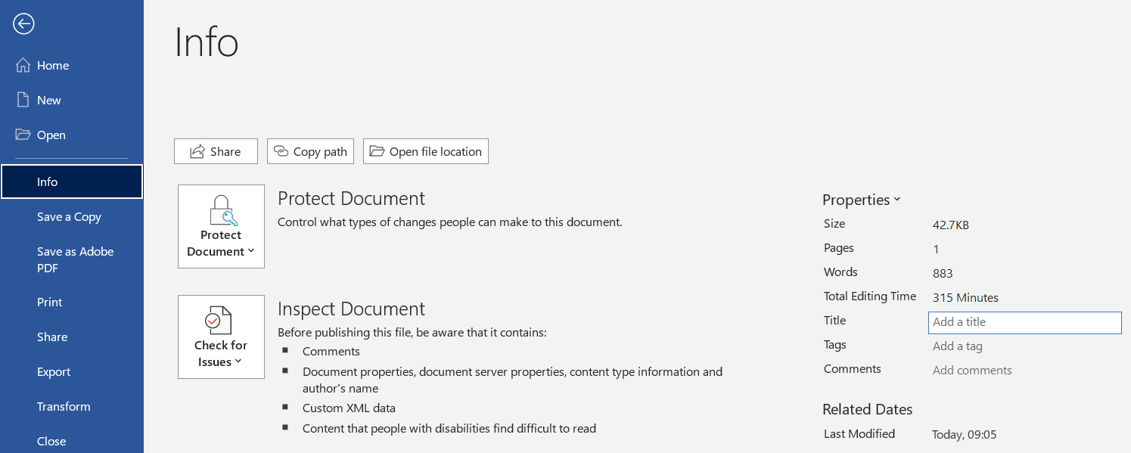
Setting the title
Notes:
So how do you set the title of a file? In Word, PowerPoint, or Excel go to the Info menu.
[progress]
And then set the Title according to your preference.

Slide 49

Conclusion
Notes:
So we’ve reached our conclusion.

Slide 50
From now on
It’s not good to go until it’s
Notes:
Let’s try to make this our new slogan, it’s not good to go, until the accessibility inspector says it’s good to go.
This might not be possible in all cases, but if we can set our intention to be as accessible as possible then everyone will benefit.
We’ve also learned today that the accessibility inspector cannot tell you all accessibility issues. But using it regularly will raise your awareness of what to look out for and consider as you continue on your accessibility journey.

Slide 51
Next steps
Try out the accessibility inspector.
Ask questions, share lessons and tips in the 365 Community.
Check out the links in the slide deck.
Tell us what you want the next accessibility session to cover.
Notes:
In terms of next steps, try using the accessibility inspector and post your questions about it in the Office 365 community.
We’ve added lots of links in the slide deck to help you.
And as you use the inspector give us your feedback on what you would like us to cover in a future session, so we can prepare a deeper dive into the topics that matter most to you.

Slide 52
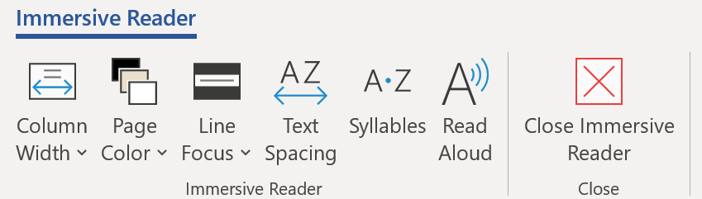
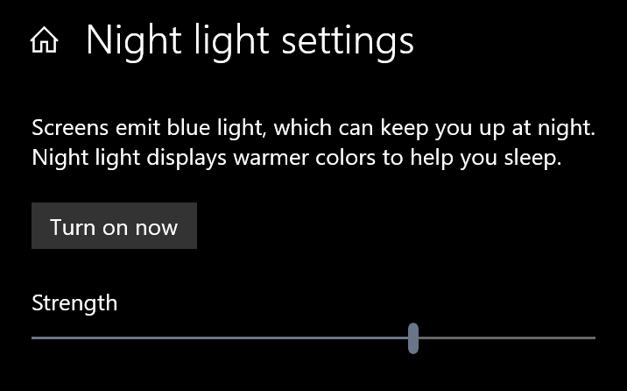
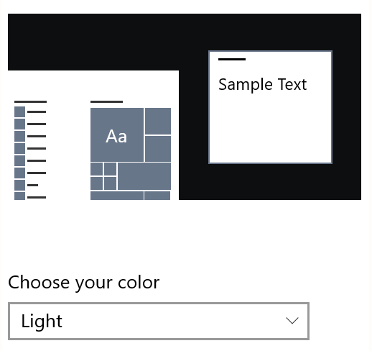
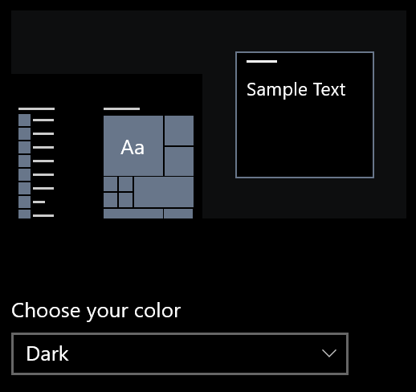
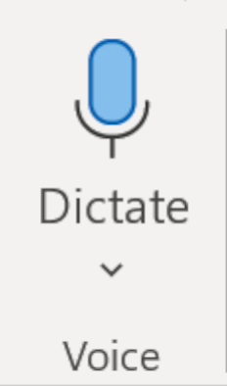
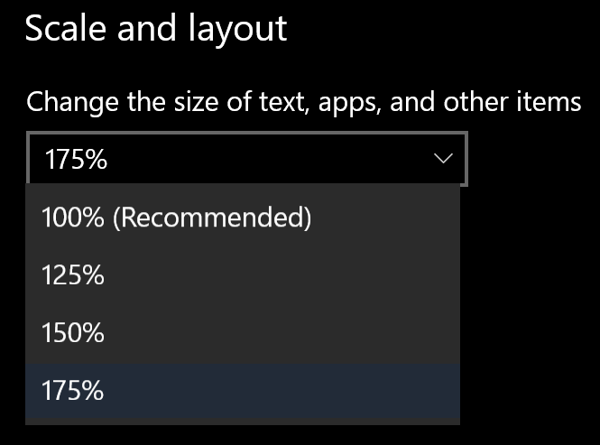
Accessibility is for everyone
Notes:
Accessibility isn’t only about making your content accessible for others. There are many accessibility tools and features that can make your life easier. For example:
[progress]
You can dictate documents and emails.
[progress]
You can use immersive reader to make content easier to read or have it read aloud to you. I use that feature often to help me proof read documents.
[progress]
You can set your computer to use a light mode or dark mode, depending on your preference. Usually everyone has a preference. It’s one of the first things I set up when I get a new machine.
[progress]
You might have heard of blue light filters or night light settings. Some find that using these whatever the time of day can help to reduce eye strain.
[progress]
And you can change the scale of how windows presents content, and make it larger if you wish.

Slide 53

Useful links
Introduction to Digital Accessibility (UoS Blackboard course)
Microsoft accessibility fundamentals: Learning Path (Microsoft)
Digital Accessibility for the Modern Workplace (LinkedIn Learning)
Dyslexia friendly style guide (British Dyslexia Association)
Notes:
We’ve added more links at the end of this presentation. There’s an introductory course about digital accessibility on Blackboard. We’ve recently extended it to include lots of guidance specifically about accessibility and Office.
Microsoft also have a short course on accessibility fundamentals.
And there’s a great short course on LinkedIn called Digital Accessibility for the Modern Workplace it’s less than an hour long and very approachable.
We mentioned that computers can’t detect all accessibility issues. I strongly recommend the dyslexia friendly style guide. There’s lots of simple and easy tips that will help you to make content more accessible.

Slide 54
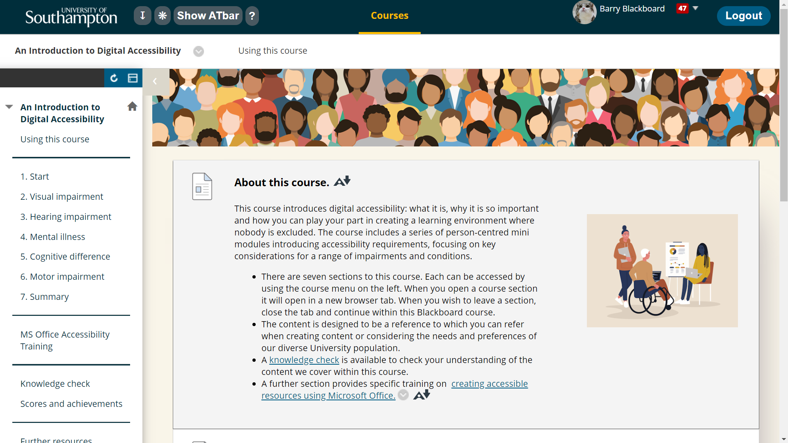
Blackboard course 1
Notes:
Here’s an example of the Introduction to Digital Accessibility Blackboard course. The course is broken into two main parts. One explains accessibility from the perspective of the lived experience of those with different types of impairment. The other is a dedicated section to Office Accessibility.

Slide 55
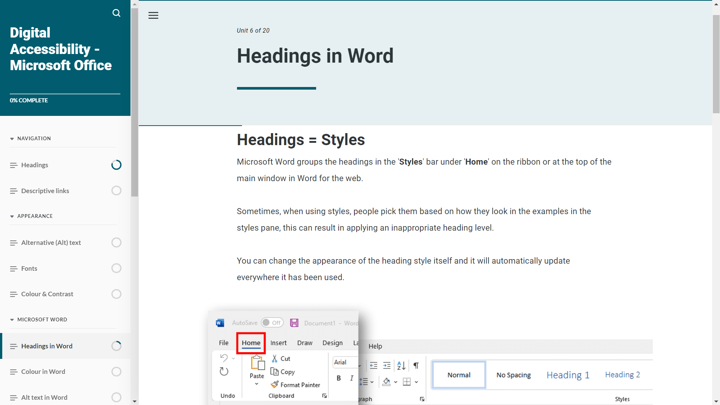
Blackboard course 2
Notes:
Here’s a screenshot from the Office accessibility section. This is a great resource for dipping in and out of to remind yourself of things we’ve covered today and futher ways you can improve accessibility of the content you create in Office.

Slide 56

Office and PDF Accessibility
PDFs
Creating accessible PDFs (UoS SharePoint)
Word
Make your Word documents accessible to people with disabilities (Microsoft)
Making Word accessible using Styles (Jon Lightfoot’s recorded presentation)
PowerPoint
Make your PowerPoint presentations accessible to people with disabilities (Microsoft)
Three ways PowerPoint’s “Design Ideas” excludes your audience, and how to fix it (Digital Learning)
Excel
Make your Excel documents accessible to people with disabilities (Microsoft)
Notes:
Pick out some links from this page

Slide 57

Make your computer work for you!
Dictate your documents in Word (Microsoft)
Use Immersive Reader in Word (Microsoft)
Reduce blue light in Windows (Microsoft)
Make text and apps bigger in Windows (Microsoft)
Make Windows easier to see (Microsoft)
Change colours in Windows (Microsoft)
Listen to your emails in Outlook (Microsoft)
My Computer, My Way (AbilityNet)
Notes:
And we’ve added some links to guides about using some of the accessibility features we mentioned in our conclusion these are based on Windows PCs.
The My Computer, My Way site has more along these lines and they cover windows, macs, iphones, android phones, and chromebooks.

Slide 58
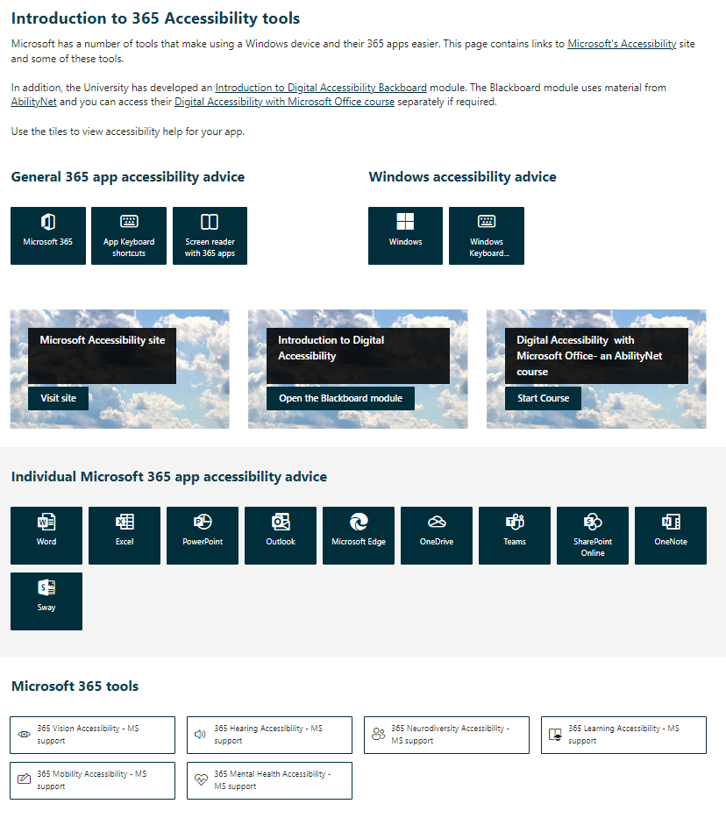
New to the 365 Community SharePoint Site
365 Community Accessibility Hub
Notes:
Julia has recently updated the 365 Community SharePoint site to include a dedicated 365 Accessibility hub where you can find out more about using Microsoft 365 tools in an accessible way and much more.

Slide 59
Discussion
Notes:
Thanks for you participation and engagement in our session, we can use the time remaining to answer your questions and discuss anything we have covered today. Thank you!

